Slide 1

SECURED EMPLOYEE DATA MANAMAGEMENT SYSTEM

Slide 2
INTRODUCTION
Today everyone is turning towards technology and they believe it is quite secure and easy to handle because of END TO END encrypted database management system.
Encrypted database management system helps us to handle our personal and important database easily.
The manager can access the whole data of their employees easily from anywhere just using their smart phone.

Slide 3
ADVANTAGES OF ENCRYPTED DATABASE
Encrypted database is more secured because even when data is stolen the attackers cannot access the data without the key.
In END TO END encryption even developers cannot see the data transferred between two users .Example :- Whatsapp.
Requires less security because data is in encrypted form.

Slide 4
The features of this program are as follows.
Administrator can add following details
Name of employee
Age of employee
ID number of employee
Mobile number of employee
Salary of employee

Slide 5
6. Sector of employee
7. Year of joining
8. Gender
9. Designation

Slide 6
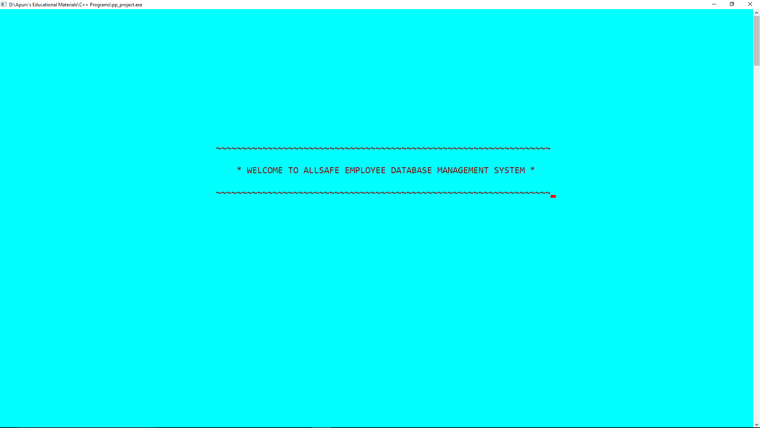
Operations that can be performed on database.
login() – This function provides the user interface for administrator to enter the username and password.
display() – This function is used to display the two lines(component of UI) after 1.5 sec.

Slide 7
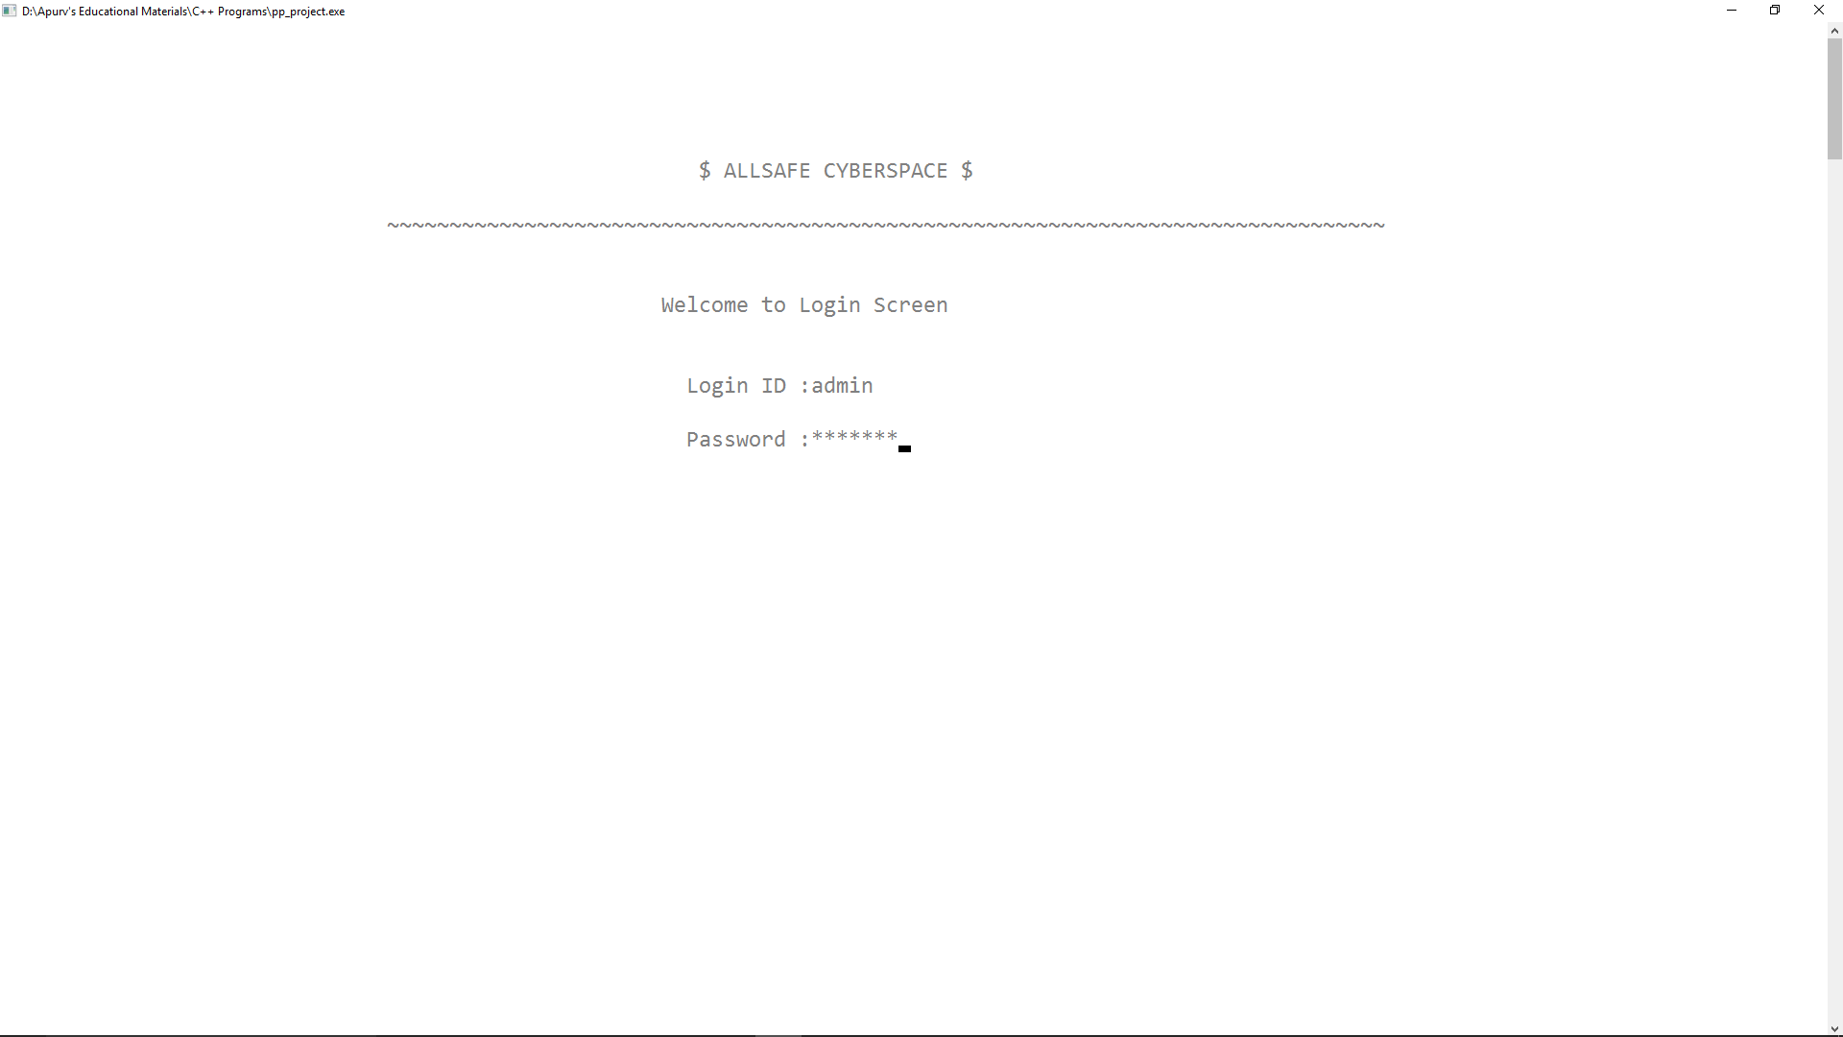
choice() - This function checks the password entered by administrator and if the password is correct it allows to enter the database and also provides the user interface to choose the operations like end, decrypt, encrypt, write, delete, search, modify, read.

Slide 8
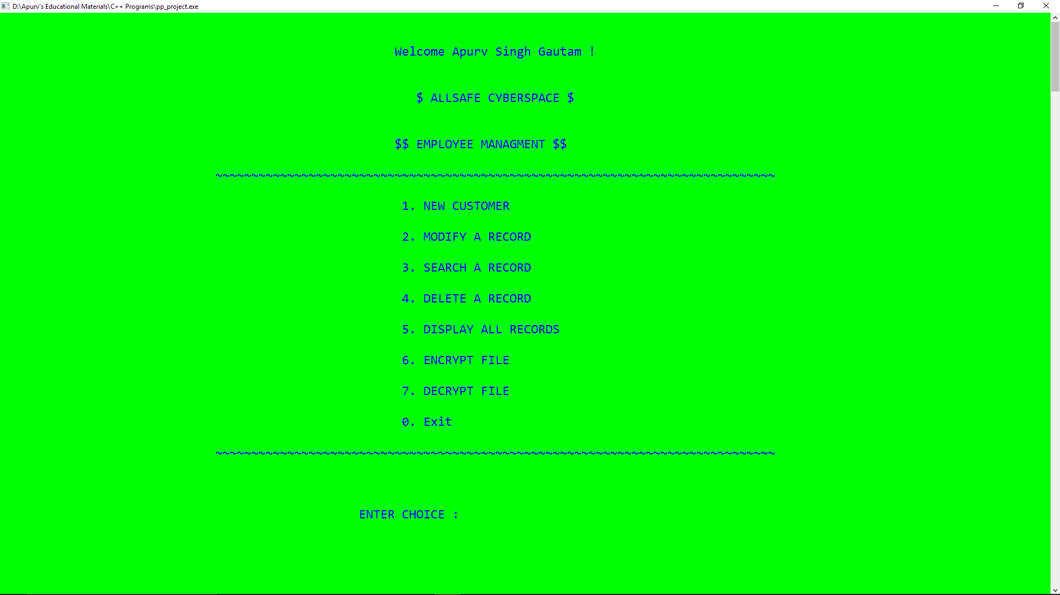
read() – This function is used to call getdata() and decide that more record are to be entered or not.
getdata() – This function is called in read function to get the data of one employee.

Slide 9
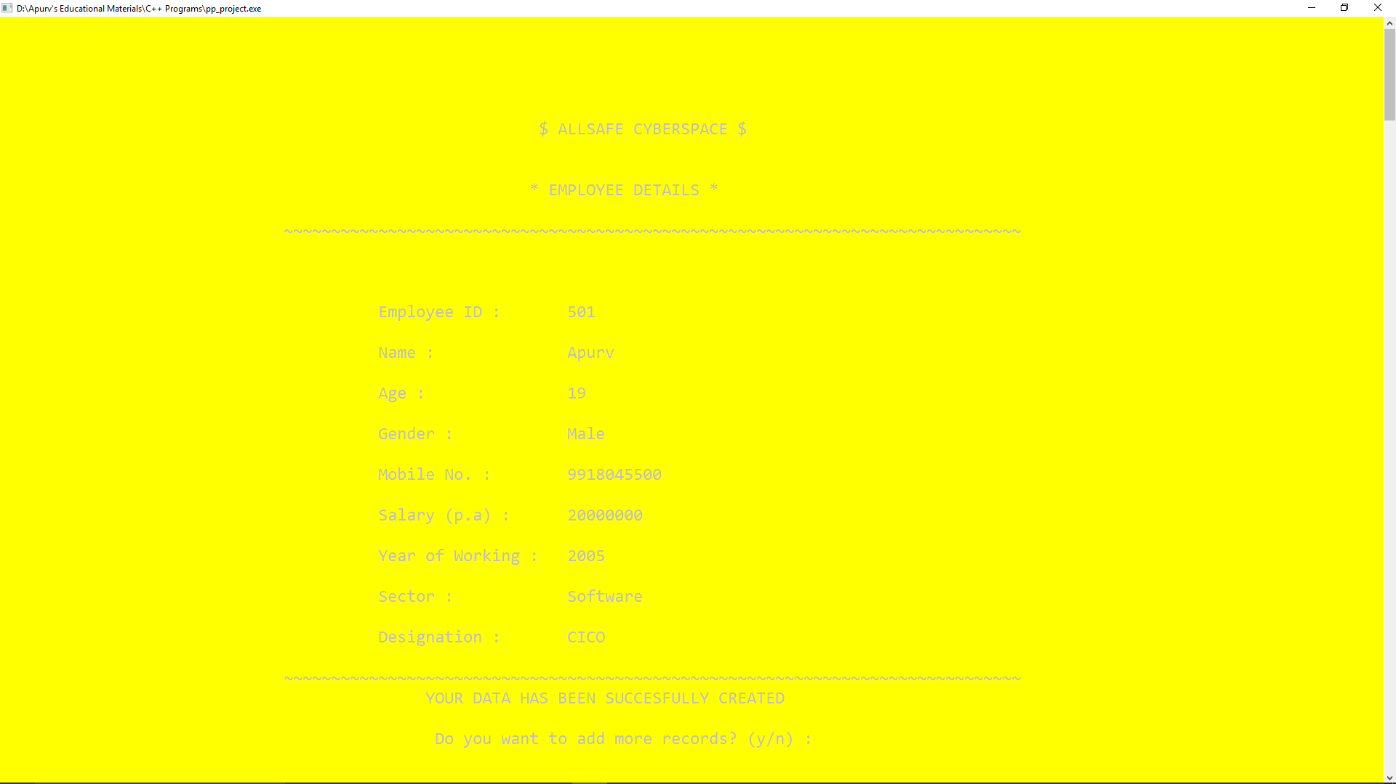
write() – This function is used to create user interface for entering the data.

Slide 10
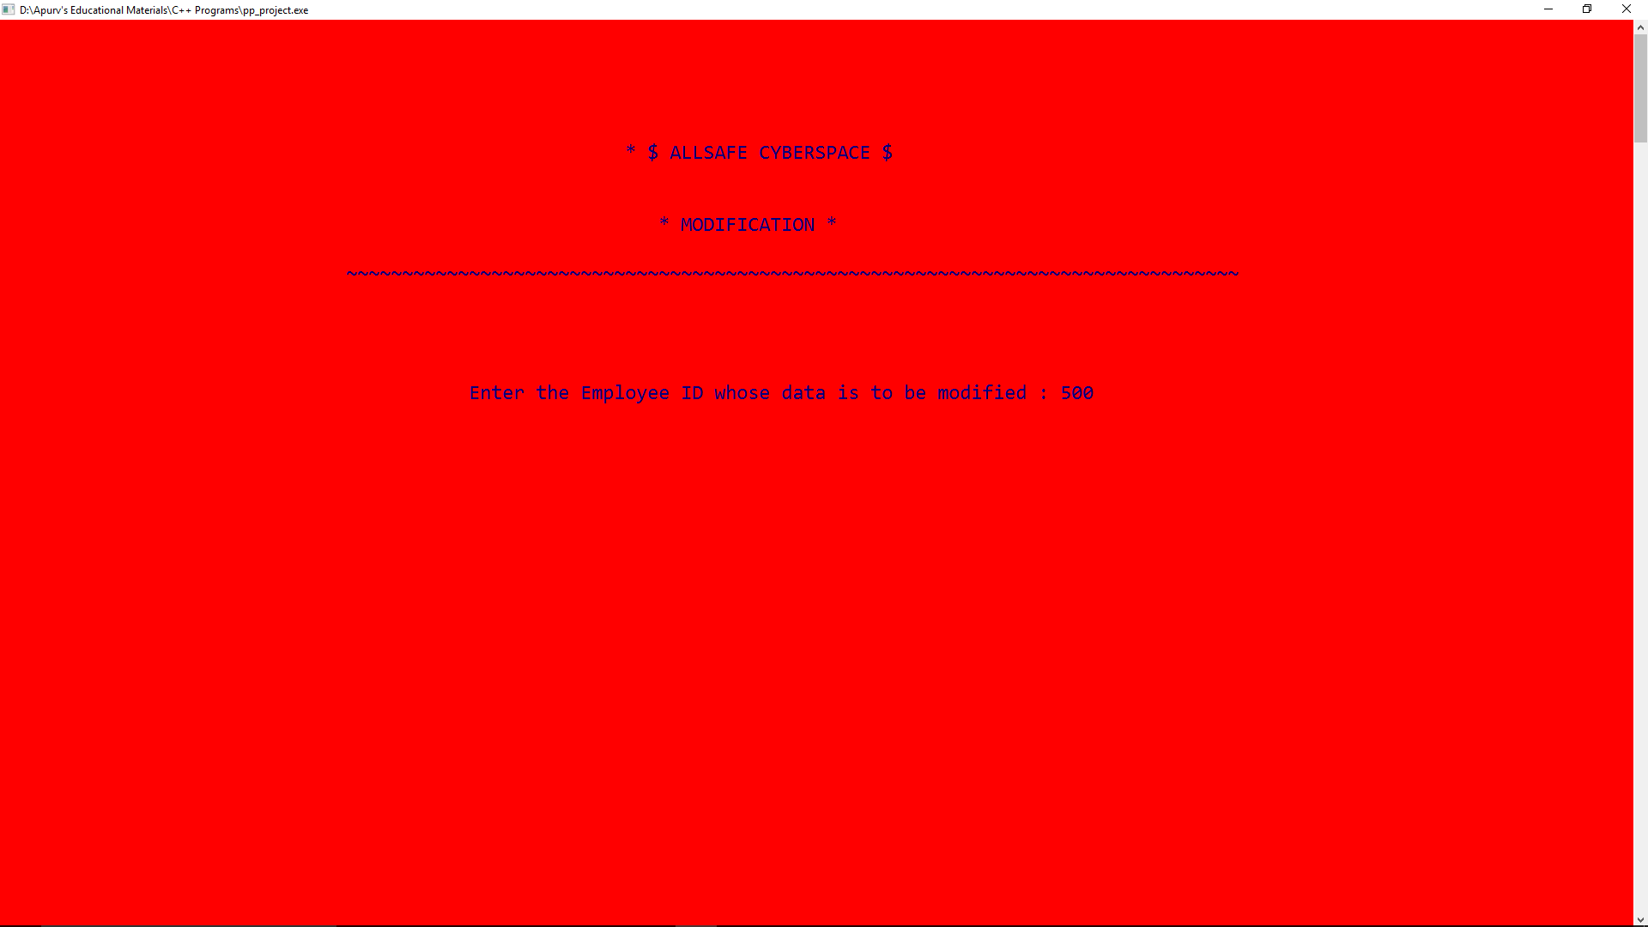
modify() and modifydata() – These functions are used to modify the existing data.

Slide 11
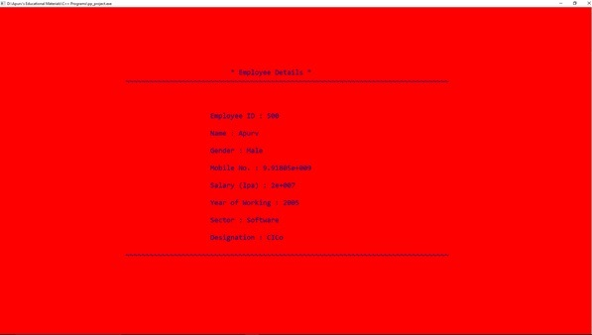
displaydata() – This function display the single record from data.

Slide 12
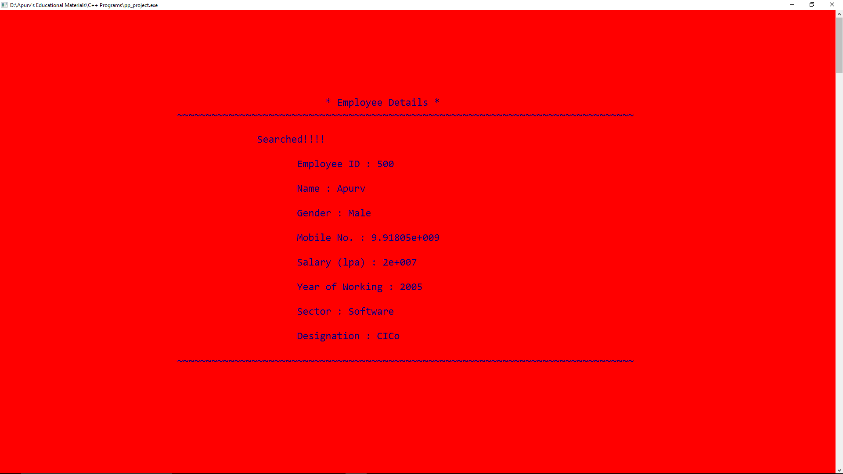
search() – This function is used to search a particular record in database.

Slide 13
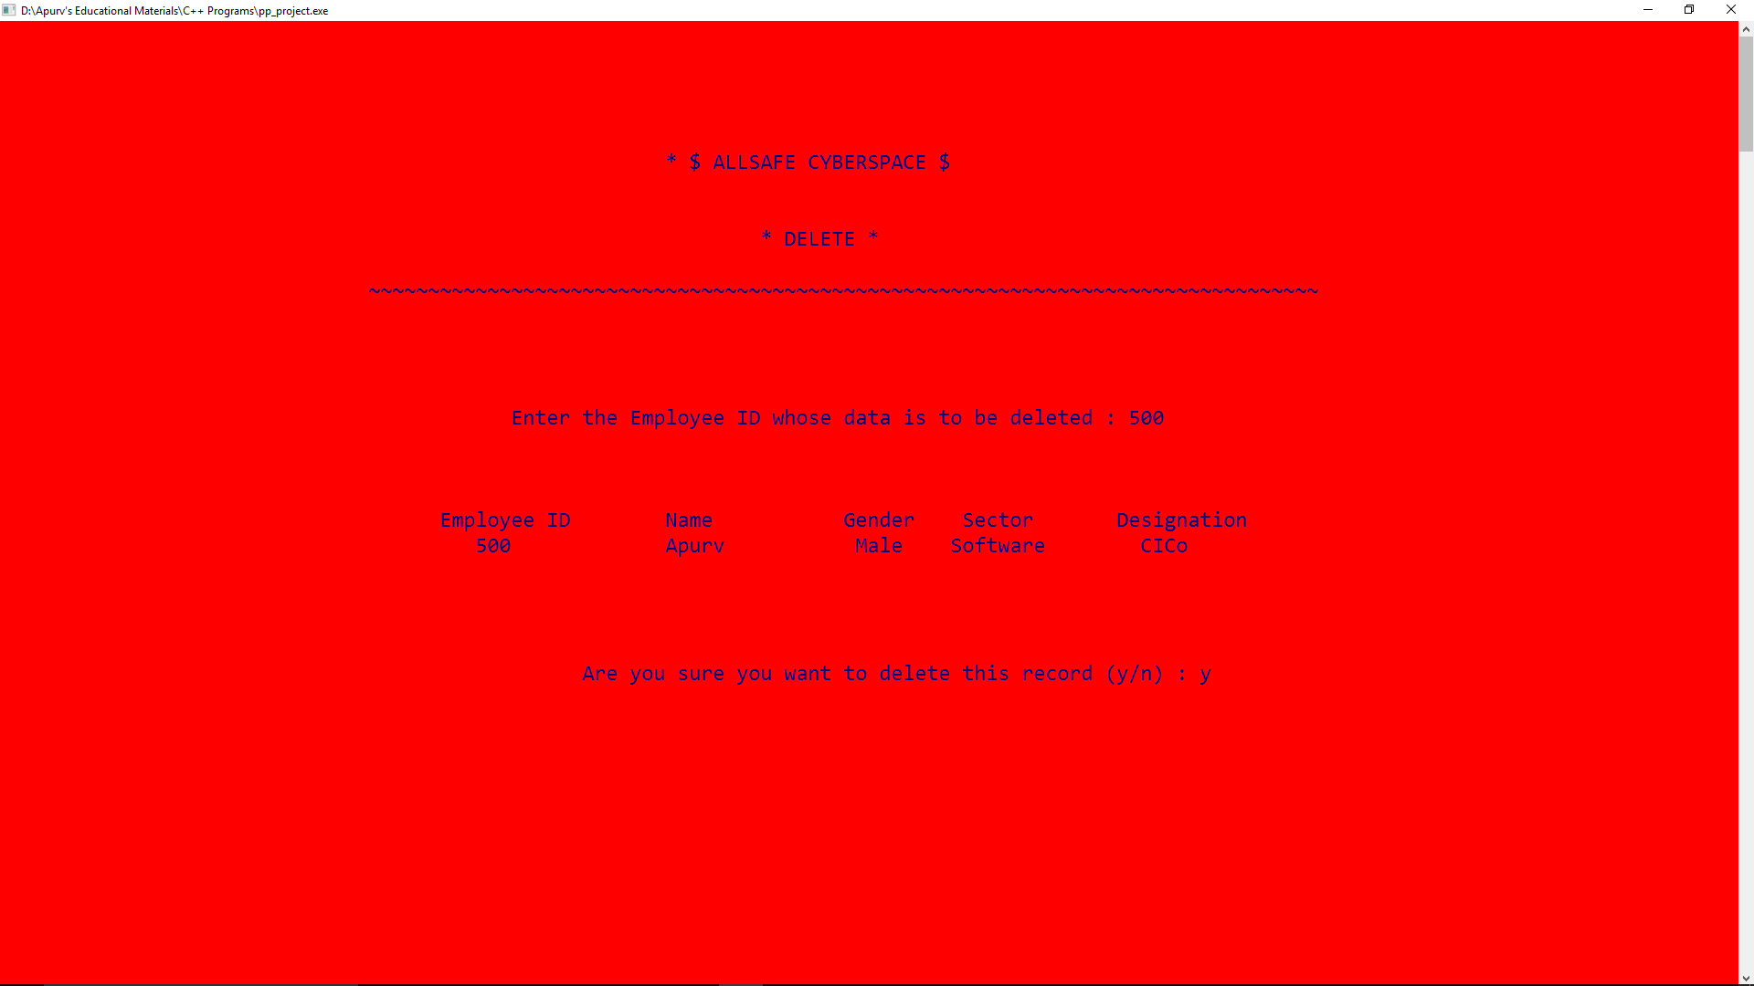
deleted() – This function is used to delete the particular record from the database.

Slide 14
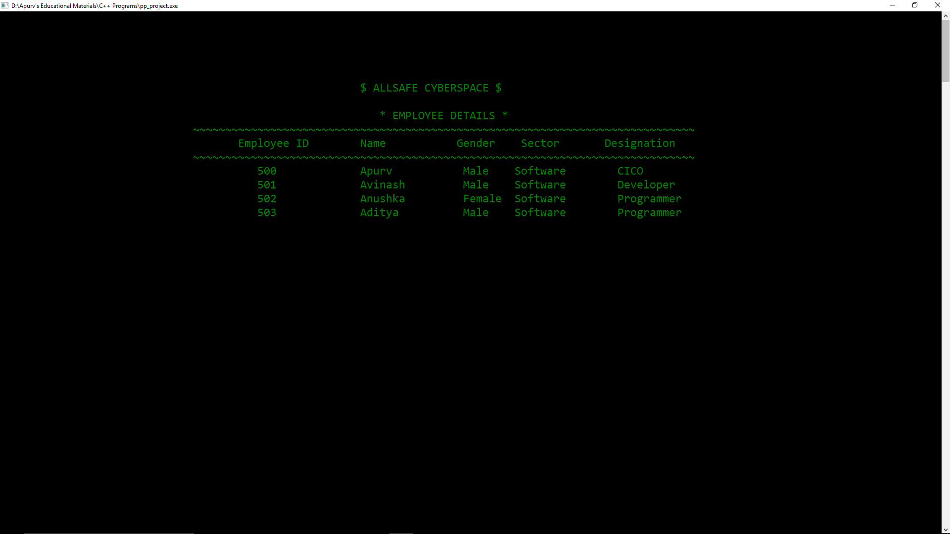
displayall() – This functions is used to display the whole database together.

Slide 15
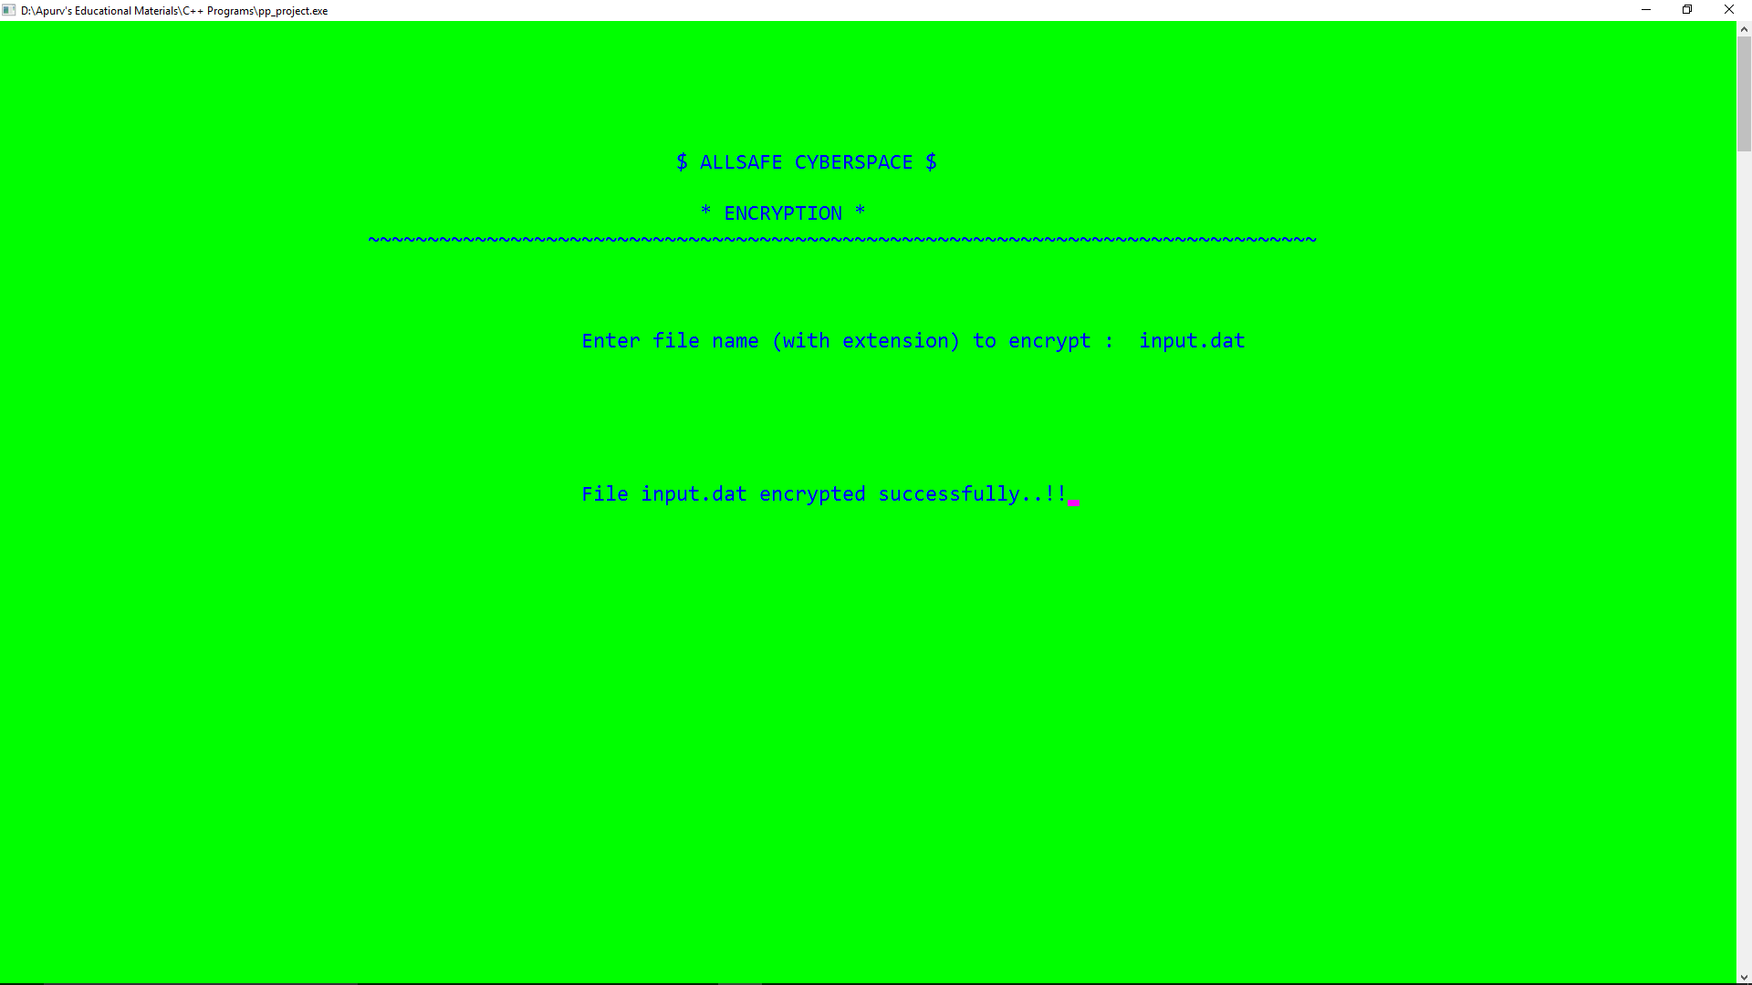
encrypt() – This function is used to encrypt the data to unreadable format.

Slide 16
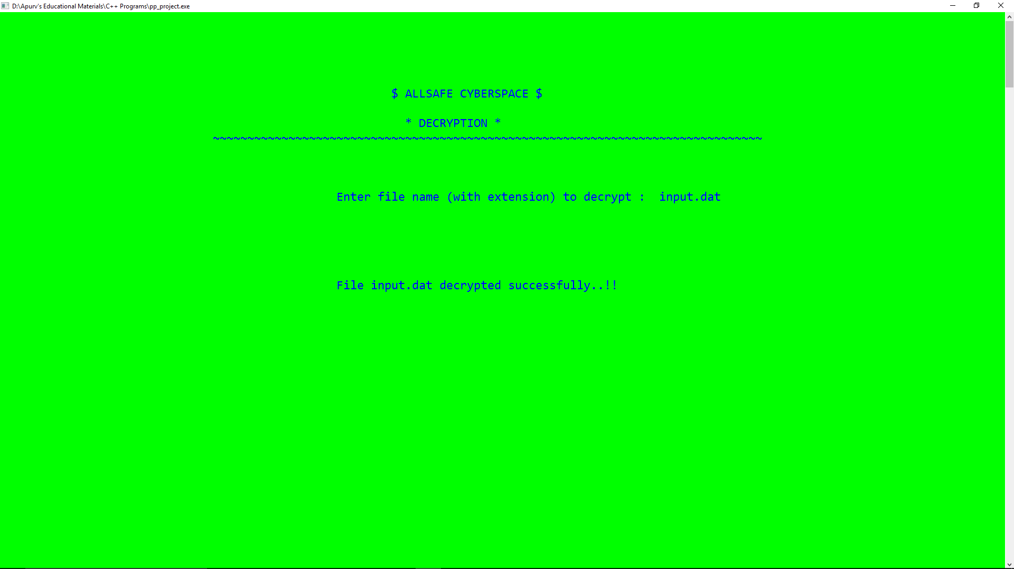
decrypt() – This function is used to decrypt the data to original format.

Slide 17
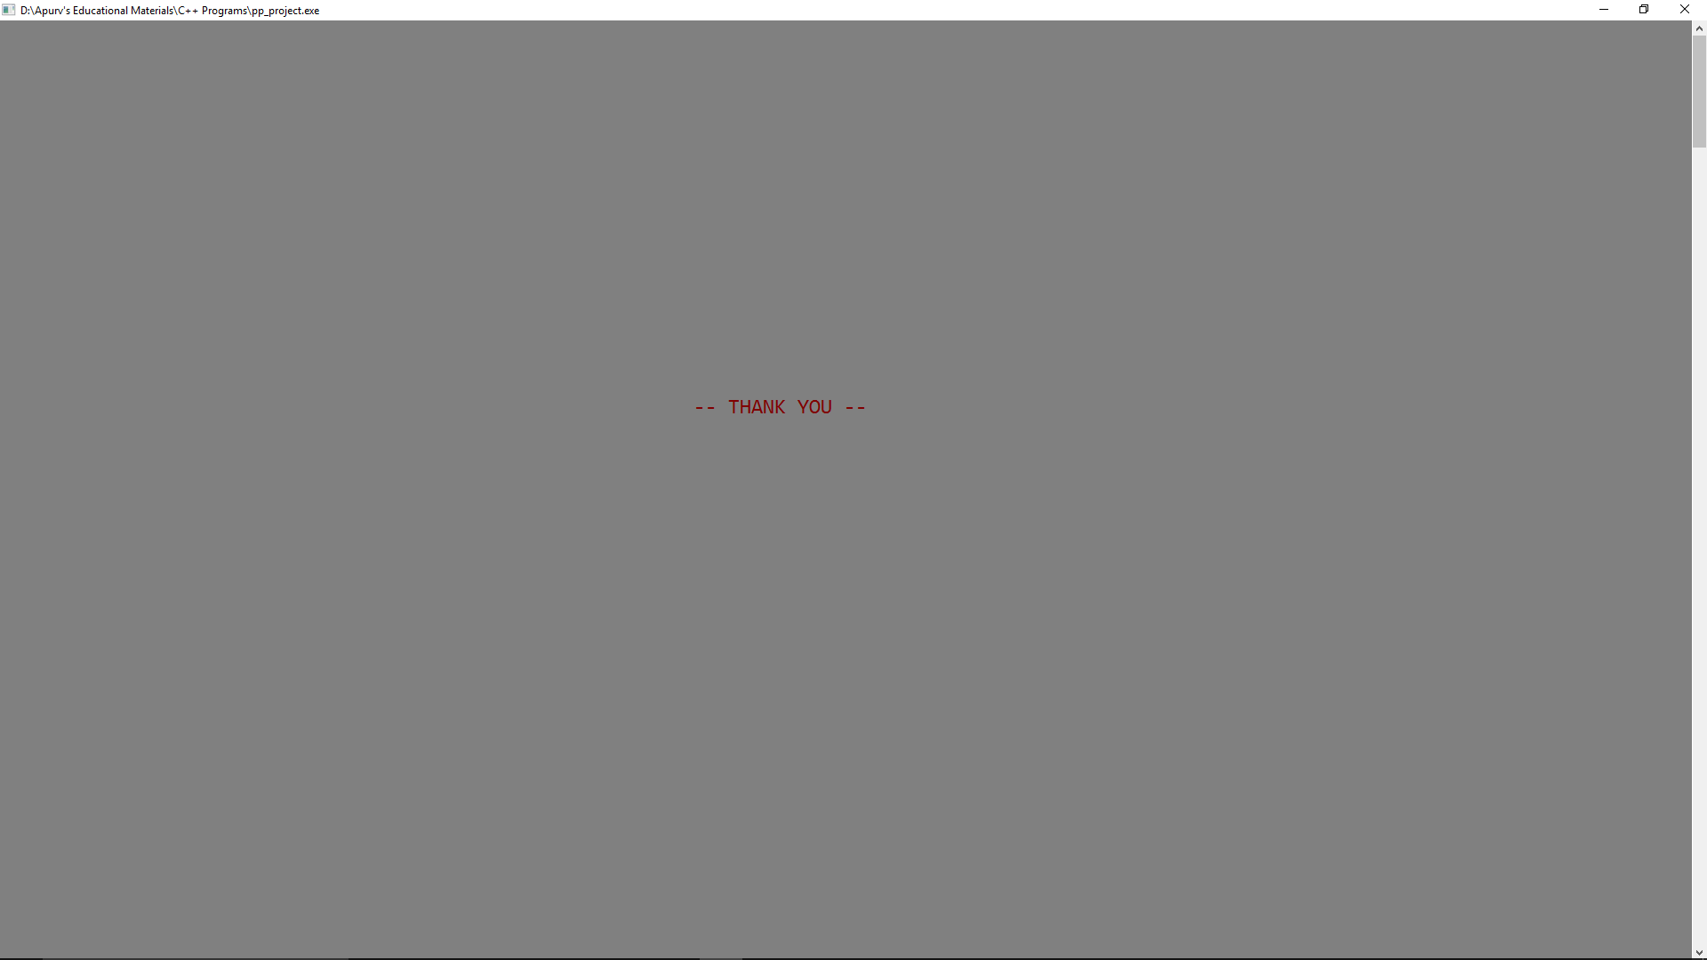
end() – This function displays the screen below.

Slide 18
CONCLUSION
For now what our knowledge says is C++ is the best programming language.
C++ language can solve almost every real world problem
C++ language should be used for making our life easy by writing such programs.

Slide 19
Thankyou !!
Made by :- Apurv Singh Gautam
Rushin Tilva

